Slide 1
SILAC
members:
1- Nada Magdy
2- Nada Abdelmohsen
3- Marwa Mahmoud
4- Nada Naser
5- Menna Talla Salah
6- Manar Ahmed Mohamed
By Dr/ Ibrahim Elawady

Slide 2
Introduction
SILAC
Stable isotope labeling by amino acids(SILAC) is a powerful approach for high-throughput quantitative proteomics. It allows highly accurate protein quantitation through metabolic encoding of whole cell proteomes . Since its introduction in 2002, SILAC has become increasingly popular.

Slide 3
How it works
Quantitation of a protein can be achieved by comparing its MS signal intensities across different samples. First, heavy stable isotopes are introduced into proteins/peptides in one or more of the experimental conditions to be compared. Then the heavy labeled sample is mixed with the unlabeled (light) sample and the mixture is analyzed by MS. The heavy labeled introduces a predictable mass shift compared to the light sample, which can be readily detected by MS.
Because the labeled and unlabeled have the same chemical and physical properties, they have the same signal response factor in the mass spectrometer.

Slide 4
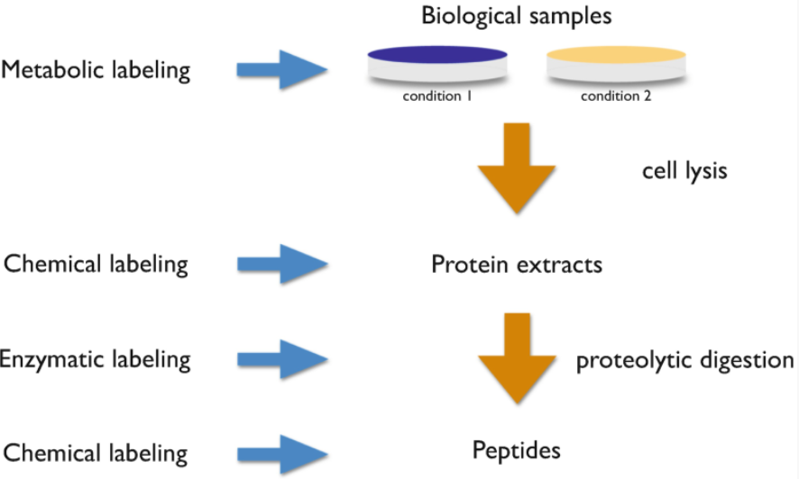
The categories of SILAC
Chemical labeling such as ICAT(Isotope Coded Affinity Tag), iTRAQ(Isobaric Tags for Relative and Absolute Quantitation), TMT(Tandem Mass Tagging) in which labels are attached to proteins/peptides through chemical derivatization.
Enzymatic labeling such as (H₂¹⁶O/H₂¹⁸O) in which labeling is introduced through enzymatic reaction.
Metabolic labeling such as SILAC in which labeling is incorporated into proteins during in protein synthesis.

Slide 5
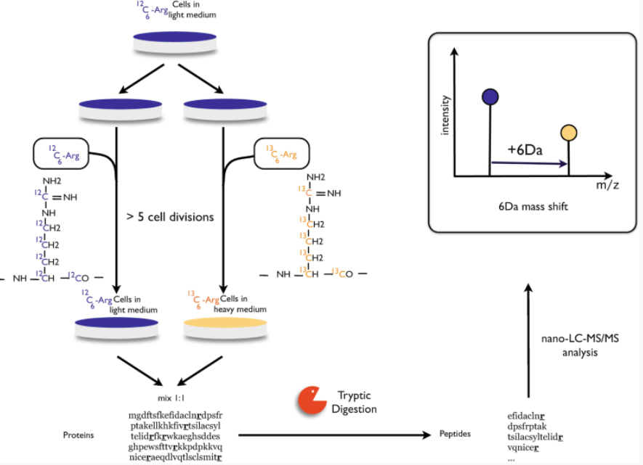
SILAC experiment
In this figure, cells are differentially labeled in medium with normal arginine or medium with heavy arginine.
Cells need to be maintained in SILAC media for at least five cell divisions to ensure virtually complete labeled of proteins.
Then the two cell populations are combined, digested with trypsin and analyzed by LC-MS/MS.
The trypsin divides carboxy-terminal to lysine and arginine residues, double labeled with lysine and arginine ensures that every trypsin peptide (except C-terminal peptides) contains a heavy amino acid and can be used for protein quantitation.
Finally, The trypsin deviation creates pairs of peptides differing by 6 Da due to the molecular weight difference between ¹²C₆-arginine and ¹³C₆-arginine

Slide 6
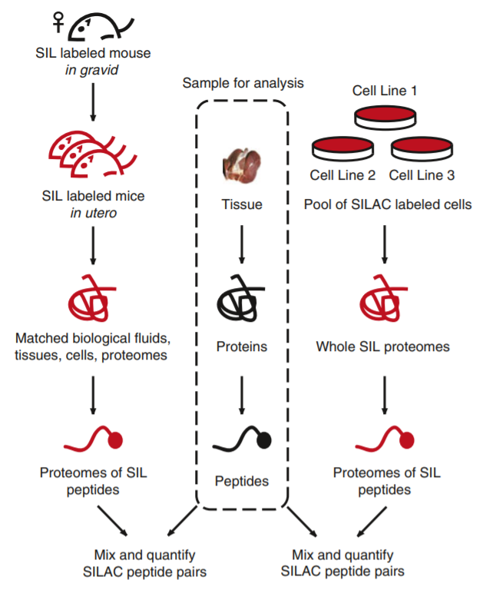
Applications and Examples of SILAC
1 - SILAC to generate analytical reagents:
Fig. Proteomes of stable isotope labeled peptides can be generated by whole organism labeling (SILAC mouse [24] shown on the left) or a super-SILAC approteomes suitable for quantifying the target tissue (dashed box), spiking in the SILAC proteome standard allows the typical SILAC quantitative workflow and proteomic profilingproach [46–48]. By selecting matched proteomes suitable for quantifying the target tissue (dashed box), spiking in the SILAC proteome standard allows the typical SILAC quantitative workflow and proteomic profiling

Slide 7
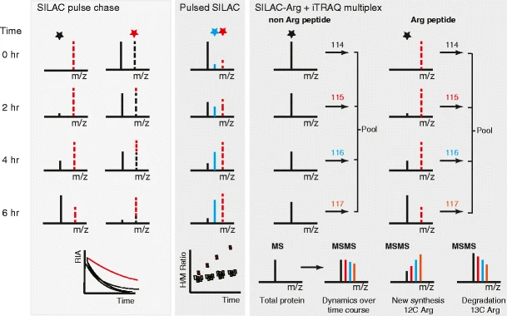
2 - SILAC to study protein turnover
In fig .Pulse-chase or 'dynamic SILAC' approach as described by the Beynon [69] and Mann [73] groups. Cells are grown in one SILAC state but then switched to another. Proteins' incorporation rates at each time point are collated over time.

Slide 8
The future of quantitative MS
As LC-MS platforms continue to improve in sensitivity and throughput, instrument vendors are developing simpler, yet formidably capable, MS instruments. The next few years will likely see steady adoption of these peptide sequencing workhorses and MS-based analyses becoming a standard assay in many research laboratories. Although the speed and sensitivity of instruments will continue to improve, it is unlikely that we will comprehensively sample whole unfractionated proteome samples using current approaches. Stable isotope labeling-based MS quantification methods will continue to provide better quantitative data over non-intensity-based measures of peptide abundance. As newer reagents and methods become available, software and data analysis packages will evolve alongside, lowering the barrier for entry in using stable isotope labeling.

